Slide 1
The Tools
Android Mobile Development

Slide 2
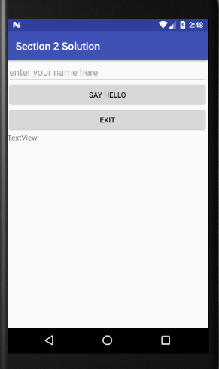
Exercise
Make an app with these user interface :

Slide 3
Exercise
Add 2 Buttons, 1 EditText, and 1 TextView
The buttons will do as follow :
The SayHello Button will display the text that’s been inputted in the EditText onto the TextView plus a “Hello” string in front of it
For example, if you put “Magga” as an input in EditText, the TextView should display “Hello Magga”
You can use the function .setText(YOUR_TEXT_HERE) to display some message to the TextView object
You can use “+” to concatenate 2 strings

Slide 4
Exercise
The Exit buttons will (you guess) exit the app when you click it
You can use finish() function to do that

